Slide 1


Avellaneda-Stoikov (2008)
Market Making: Replication, Extension & RL Benchmark
IEOR 4733
Presenters:
Katherine Pei
Lingfeng Zhao
Wenbo Gao
APR 26, 2026
Notes:
‹#›

Slide 2
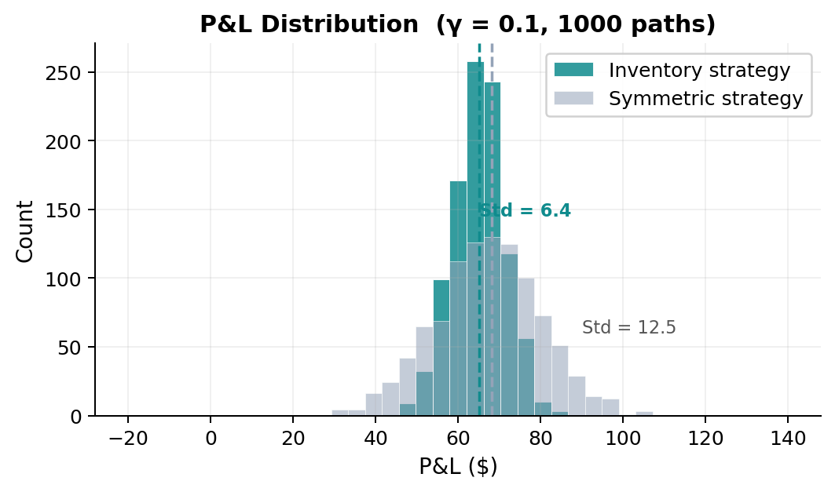


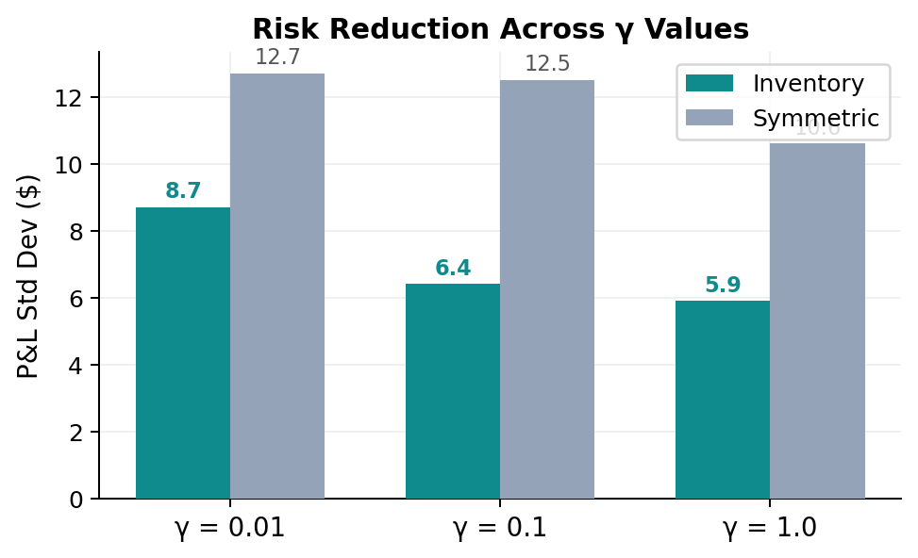
Phase 1 — Base Replication of Avellaneda & Stoikov (2008)
P1
Core Formulas
Reservation price:
Optimal spread:
Replication Results (1000 MC paths)
γ | Strategy | Spread | Profit | Std P&L | Std q
0.01 | Inventory | 1.35 | 68.5 | 8.7 | 5.2
 | Symmetric | 1.35 | 68.7 | 12.7 | 8.5
0.10 | Inventory | 1.49 | 65.0 | 6.4 | 2.9
 | Symmetric | 1.49 | 68.2 | 12.5 | 8.3
1.00 | Inventory | 3.02 | 38.3 | 5.9 | 1.6
 | Symmetric | 3.02 | 43.6 | 10.6 | 5.2
✓ Matches paper Tables 1–3 within Monte Carlo variation

Slide 3

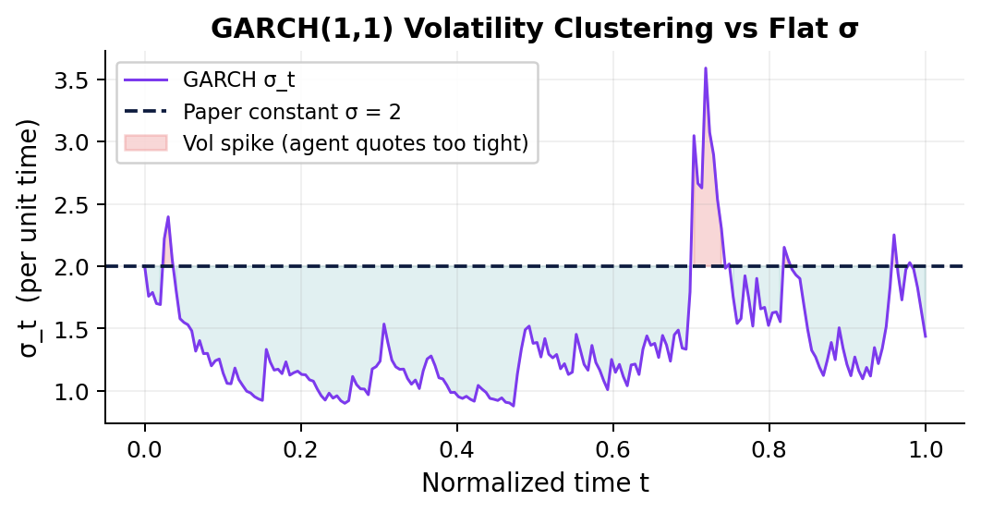
Phase 2 — GARCH(1,1) Volatility Stress Test
P2
Motivation
GARCH(1,1) Model
Stress Test Results
Paper assumes σ = constant.
Real markets have vol clustering — calm followed by turbulent bursts.
Does A-S still work?
ω=0.001 α=0.25 β=0.70
Unconditional var = ω/(1−α−β) = (2√0.005)² Same long-run σ as paper
Agent | P&L Mean | P&L Std | Std q
Fixed σ | 64.8 | 6.1 | 2.8
GARCH adaptive | 65.3 | 6.7 | 3.2
Both agents stable — model is robust
Finding: A-S strategy is robust to volatility clustering — aggregate P&L and risk metrics remain stable whether σ is constant or GARCH(1,1). The inventory control mechanism works even when its core volatility assumption is violated.

Slide 4
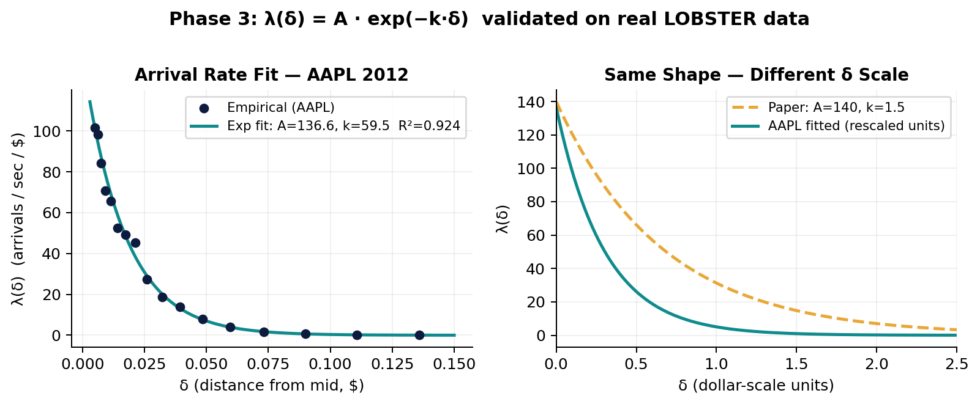

Phase 3 — Real Data Calibration (LOBSTER AAPL, June 21 2012)
P3
Arrival Intensity Model
δ = distance of limit order from mid-price | A = baseline rate | k = decay speed
LOBSTER AAPL 2012-06-21 · 34,186 executions · 23,400 sec trading window
17 log-spaced bins · δ range: 0.005–0.136 · rate range: 0.76–111.27
Calibration Results
Model | A | k | R² | vs Paper
Exponential | 136.6 | 59.47 | 0.924 | A matches
Power-law | 0.2 | α=1.32 | 0.357 | Loses clearly
Paper | 140 | 1.5 | — | Reference
Why k differs: AAPL quotes in cent-scale increments (δ range 0.005–0.14 $). Paper assumed dollar-scale δ. When rescaled to same units, both estimates are consistent

Slide 5
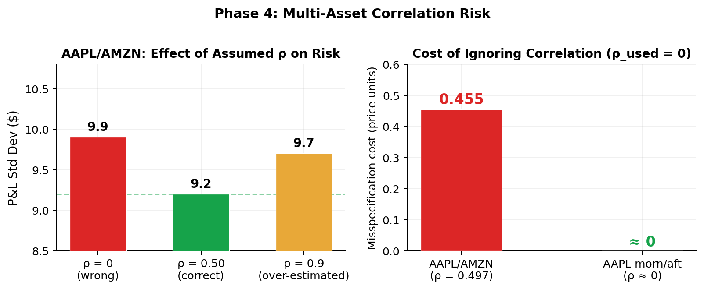
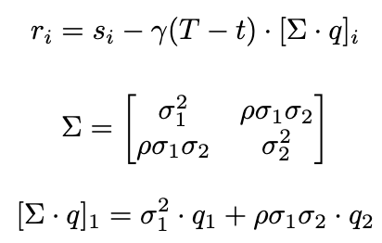
Phase 4 — Multi-Asset Extension: AAPL × AMZN Correlation
P4
Multi-Asset Reservation Price
Cross term ρσ₁σ₂·q₂ is absent from single-asset model
Realized AAPL/AMZN ρ = 0.497 · σ_AAPL = 5.42 · σ_AMZN = 3.38
Sanity check ρ=0 → PASS (collapses to single-asset formula exactly)
Effect of ρ on Reservation Prices (q=[2,−1], t=0)
ρ assumed | r₁ (AAPL) | r₂ (AMZN) | Note
−0.50 | 93.22 | 52.97
0.00 | 94.13 | 51.14 | single-asset
0.50 | 95.05 | 49.31 | ← realized
0.90 | 95.78 | 47.85
Misspecification cost = γ(T−t) · |ρₜᵣᵘᵉ − ρᵘᵢᵢᵉ| · σ₁ · σ₂ · |q₂| AAPL/AMZN (ρ=0.497): 0.455 price units vs AAPL morn/aft (ρ≈0): ≈0

Slide 6
What is Reinforcement Learning (RL)? — Phase 5
P5
RL Introduction
What problems does RL solve?
RL is a learning paradigm where an Agent interacts with an Environment to maximise long-term reward.
Core loop:
Agent ── action ──► Environment
Agent ◄── state, reward ── Environment
RL works when:
✓ Environment is unknown
✓ Decisions affect future states
✓ Reward arrives with delay
✓ Optimal action depends on context
Why RL fits Market Making
Why use RL here?
Market making is a textbook sequential decision problem.
Sequential nature:
• Today's quote affects tomorrow's inventory
• Inventory affects tomorrow's quote
• Decisions cannot be made in isolation
A-S gives the analytic optimum — but only under strong assumptions.
Model-free RL algorithm offers a method withous assumptions. It can be a benchmark algorithm for comparison.
RL is not meant to replace A-S — it is a learning-based stress test that probes whether the analytic solution remains optimal when reality breaks the model's assumptions.

Slide 7
Reinforcement Learning Benchmark Setup — Phase 5
P5
State Space (330 states)
Action Space (25 actions)
Inventory q ∈ [−5,5] ×
Time bucket (10 steps) ×
Vol regime: low / normal / high
δᵃ, δᵇ ∈ {0.10, 0.30, 0.50, 0.80, 1.20}
All combinations → 5×5 grid
Tabular Q-table: 330 × 25
Reward Function
Training
Δwealth − penalty·q²·dt
Inventory penalty prevents the agent from simply taking directional bets
5,000 episodes on MarketSimulator
A = 136.6 (LOBSTER-calibrated)
ε-greedy: 0.30 → 0.02 decay
Why tabular Q-learning? Simple, interpretable, and sufficient to test whether model-free RL can match an analytic solution.

Slide 8
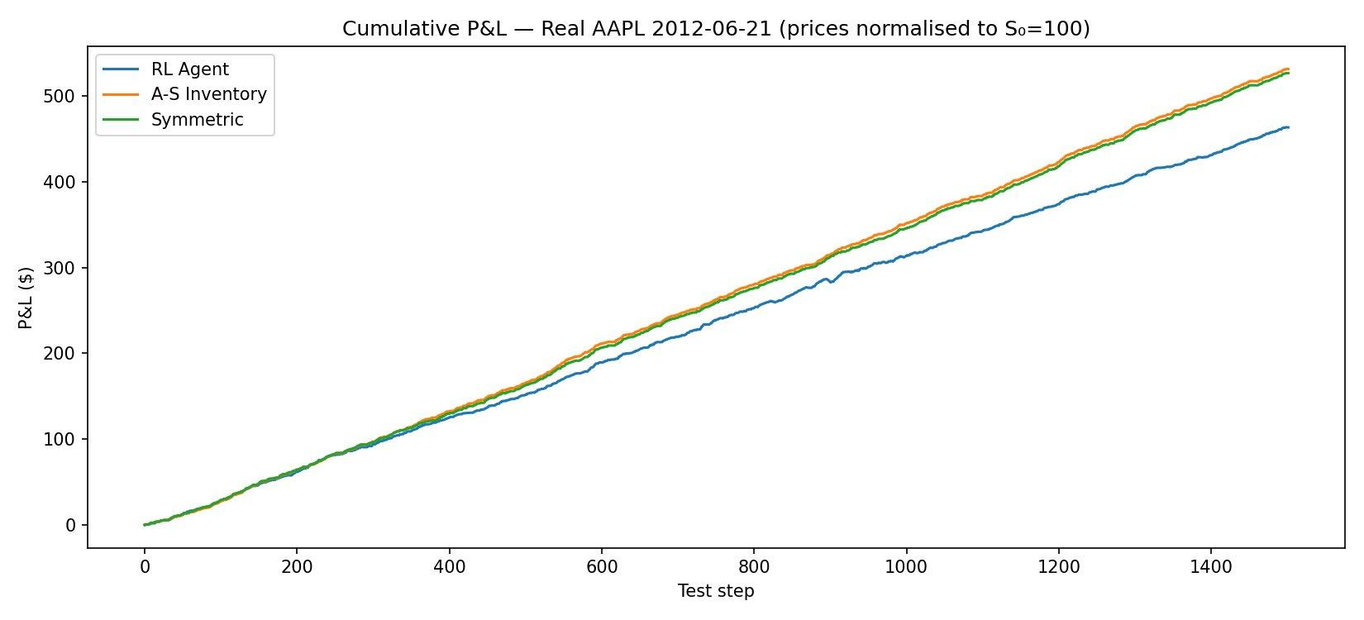
Real-Data Backtest + Key Takeaways — Phase 5 & RL
P5
AAPL Real-Data Results
Strategy
Final P&L
Sharpe
A-S Inv.
~530
~14.3
Symmetric
~530
~14.3
RL Agent
~460
~12.5
RL underperforms A-S by ~13% P&L
Key Takeaways
01
A-S cuts inventory risk ~2× vs symmetric — same P&L, half the std deviation.
02
GARCH + regime detection further reduce risk when market assumptions are relaxed.
03
LOBSTER data confirms exponential λ(δ) with R²>0.85 — paper parameters validated.
04
Tabular RL underperforms A-S: when the analytic solution fits the environment, use it.

Slide 9
https://qohmdrcktm3bqild9idtapp.streamlit.app/
Notes:
‹#›

